Slide 1
Spring Data with MongoDB

Slide 2
Objectives
Learn more about Spring Data MongoDB
Data Management
Implement CRUD (Create, Read, Update, Delete) operations to manage data effectively.
Utilize Spring Data Mongo, simplifying data persistence and retrieval.
CRUD Demo with Spring Data with MongoDB

Slide 3

What is Spring Data?
Provides a consistent abstraction layer for various data stores
Supports relational databases, NoSQL databases, and more
Offers features like repositories, query methods, and custom implementations

Slide 4
Key Features
Provides a convenient and consistent way to interact with MongoDB.
Leverages the power of Spring's core features (e.g., dependency injection, transactions).
Supports common data access patterns like CRUD operations, aggregation, and more.
Repositories: Define custom interfaces for data access, and Spring automatically generates implementations.
Query Methods: Create custom query methods using a simple naming convention.
MongoTemplate: Provides a flexible way to execute complex MongoDB queries and updates.

Slide 5
Benefits
Increased developer productivity.
Improved code maintainability and testability.
Enhanced performance with optimized data access.
Seamless integration with the Spring ecosystem.

Slide 6
Core Concepts: Repositories
Define – Don’t Implement
Create interfaces extending MongoRepository
Define CRUD methods (save, find, delete)
Spring automatically generates implementations
Example: interface UserRepository extends MongoRepository<User, String> {}

Slide 7
Query Methods
Powerful Querying with Method Names
Create custom query methods using a naming convention
Spring translates method names into MongoDB queries
Examples: findByFirstNameAndLastName
findAllByAgeGreaterThan

Slide 8
MongoTemplate
Flexible Data Access Provides a lower-level API for complex queries and updates
Supports aggregation framework, map-reduce, and more
Useful for advanced scenarios

Slide 9
Build CRUD Application with Spring Data Mongo

Slide 10
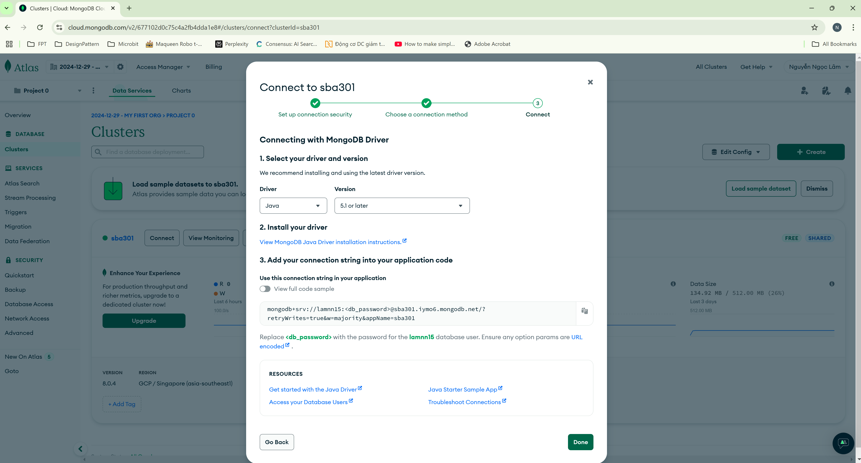
Open MongoDB Atlas

Slide 11
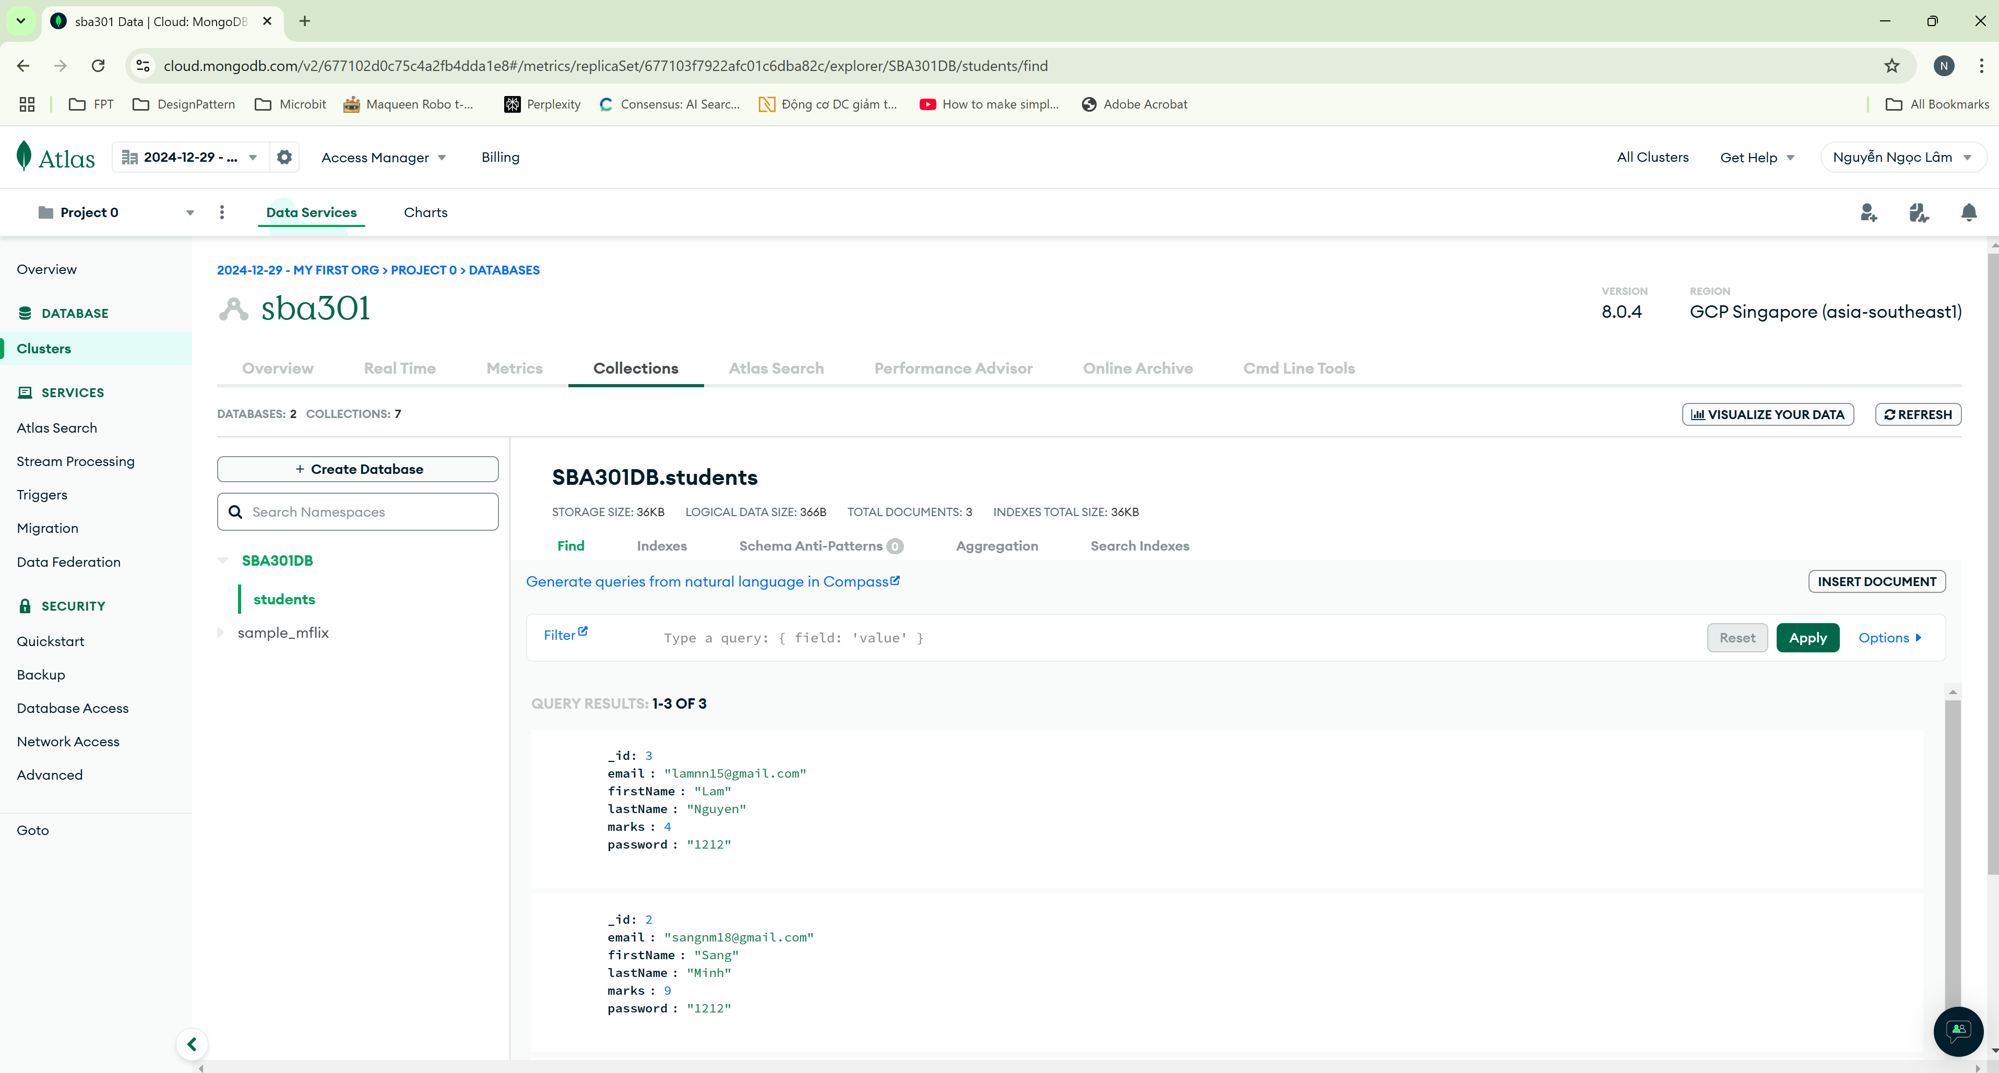
Create a database

Slide 12
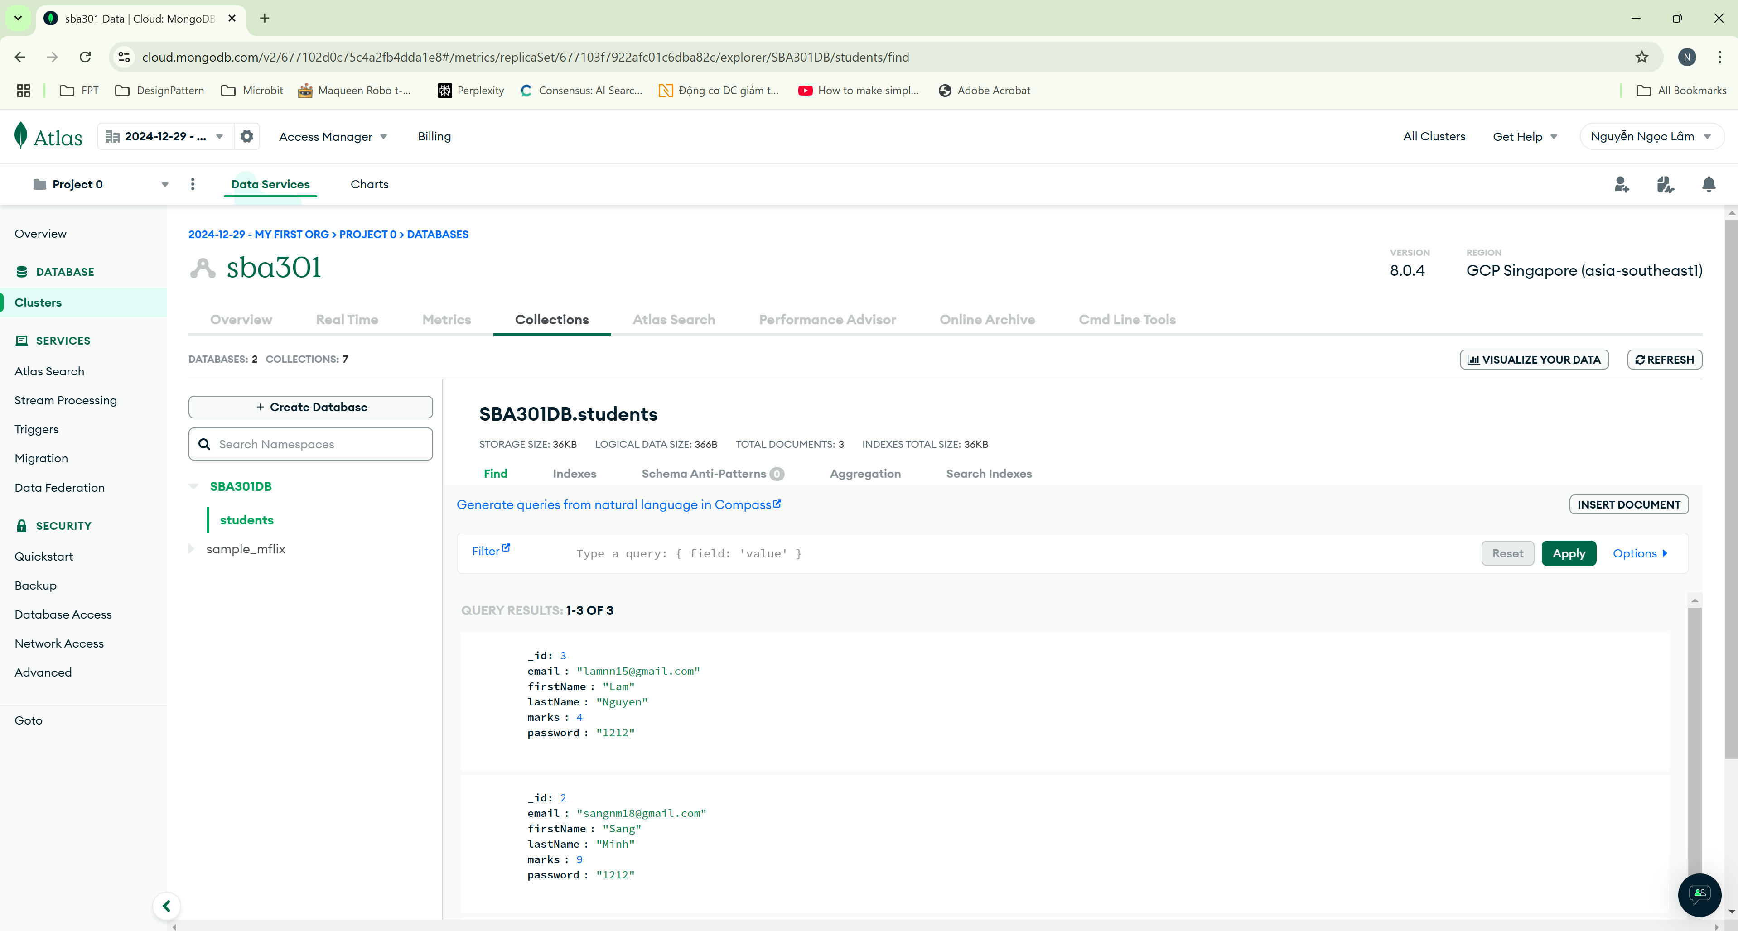
Create collections

Slide 13
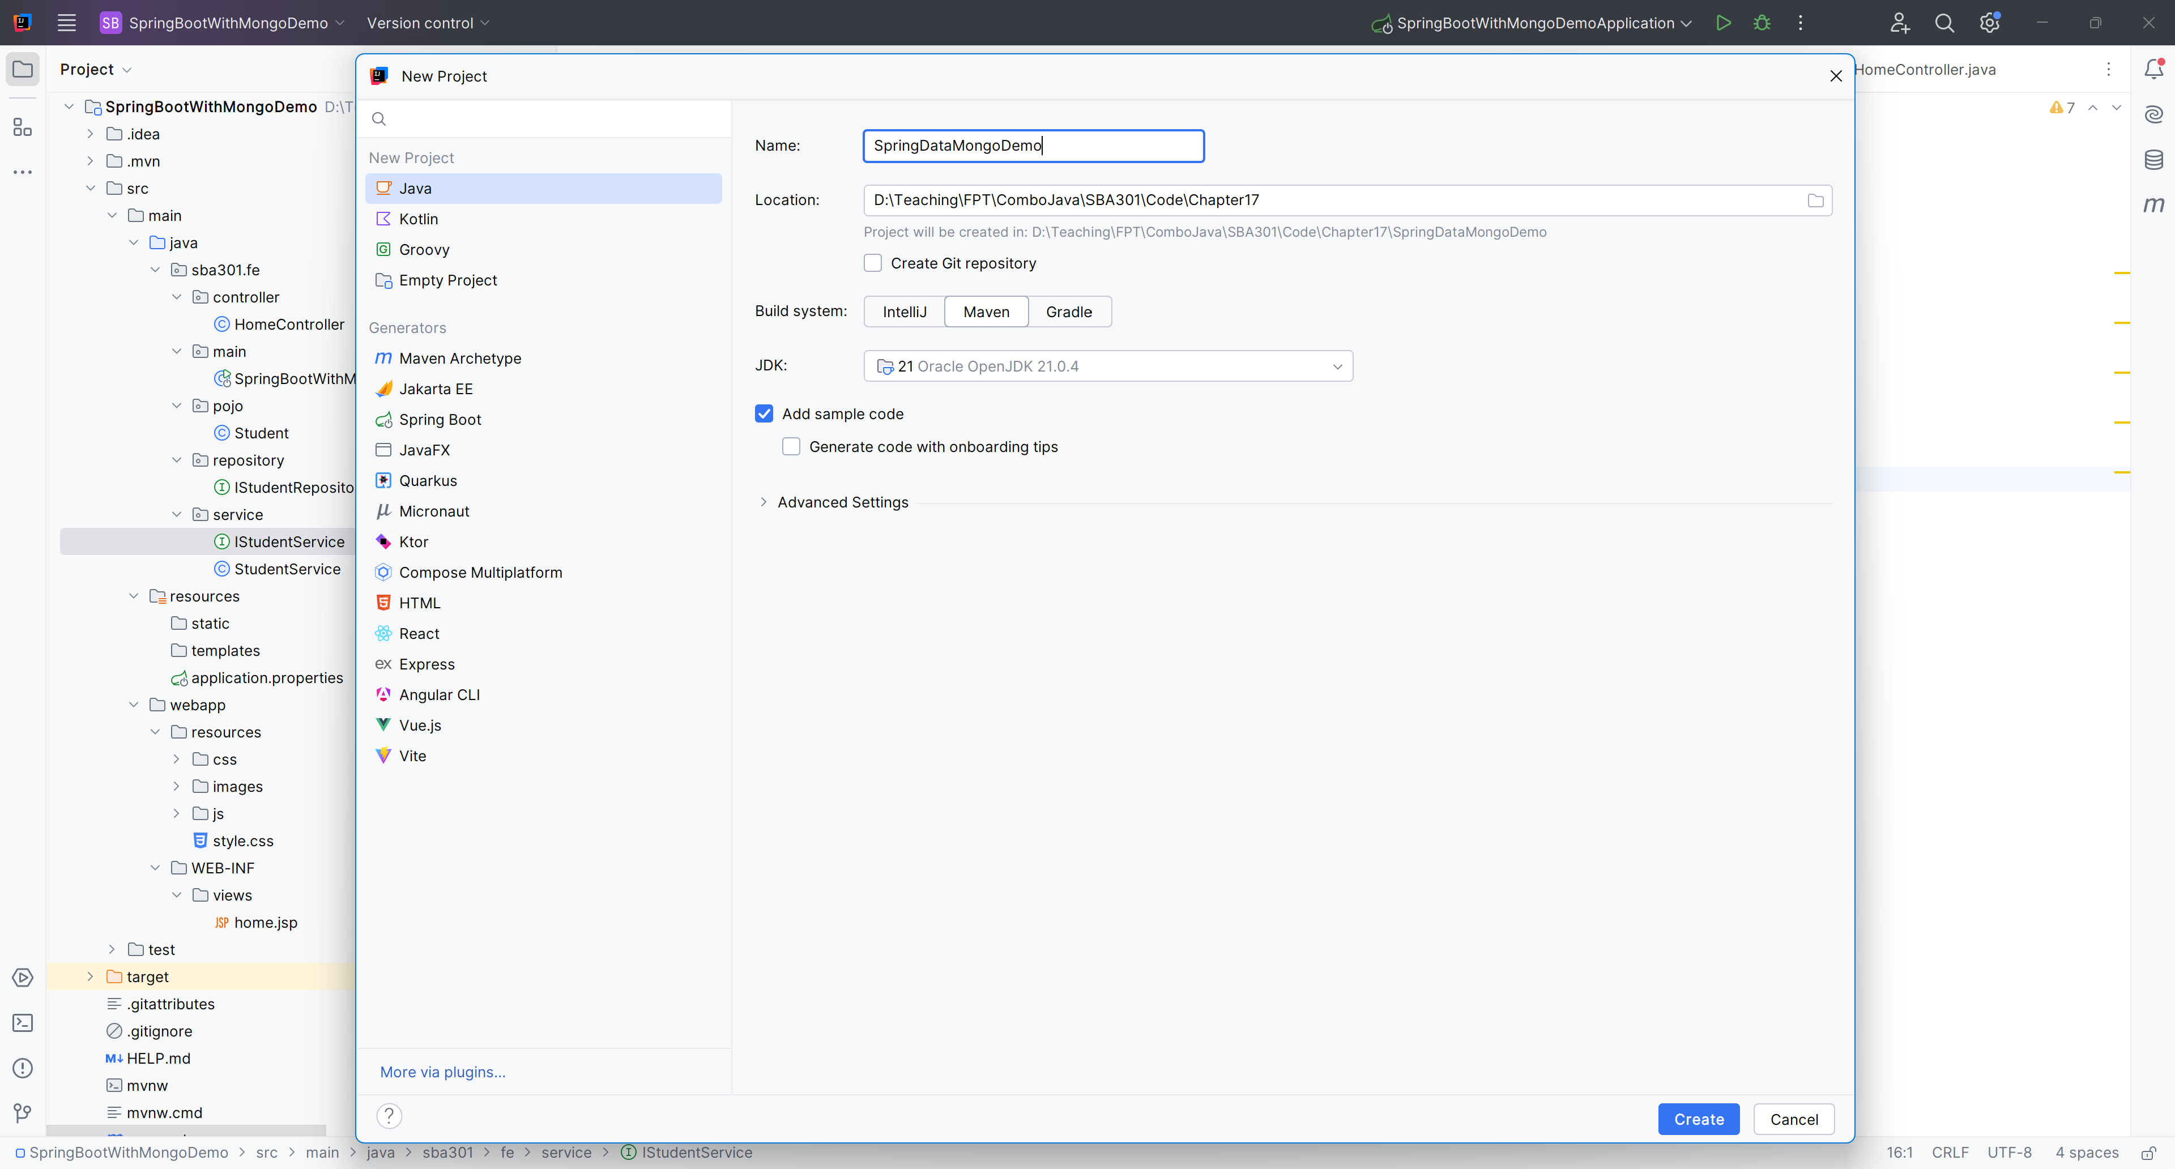
File New Project

Slide 14
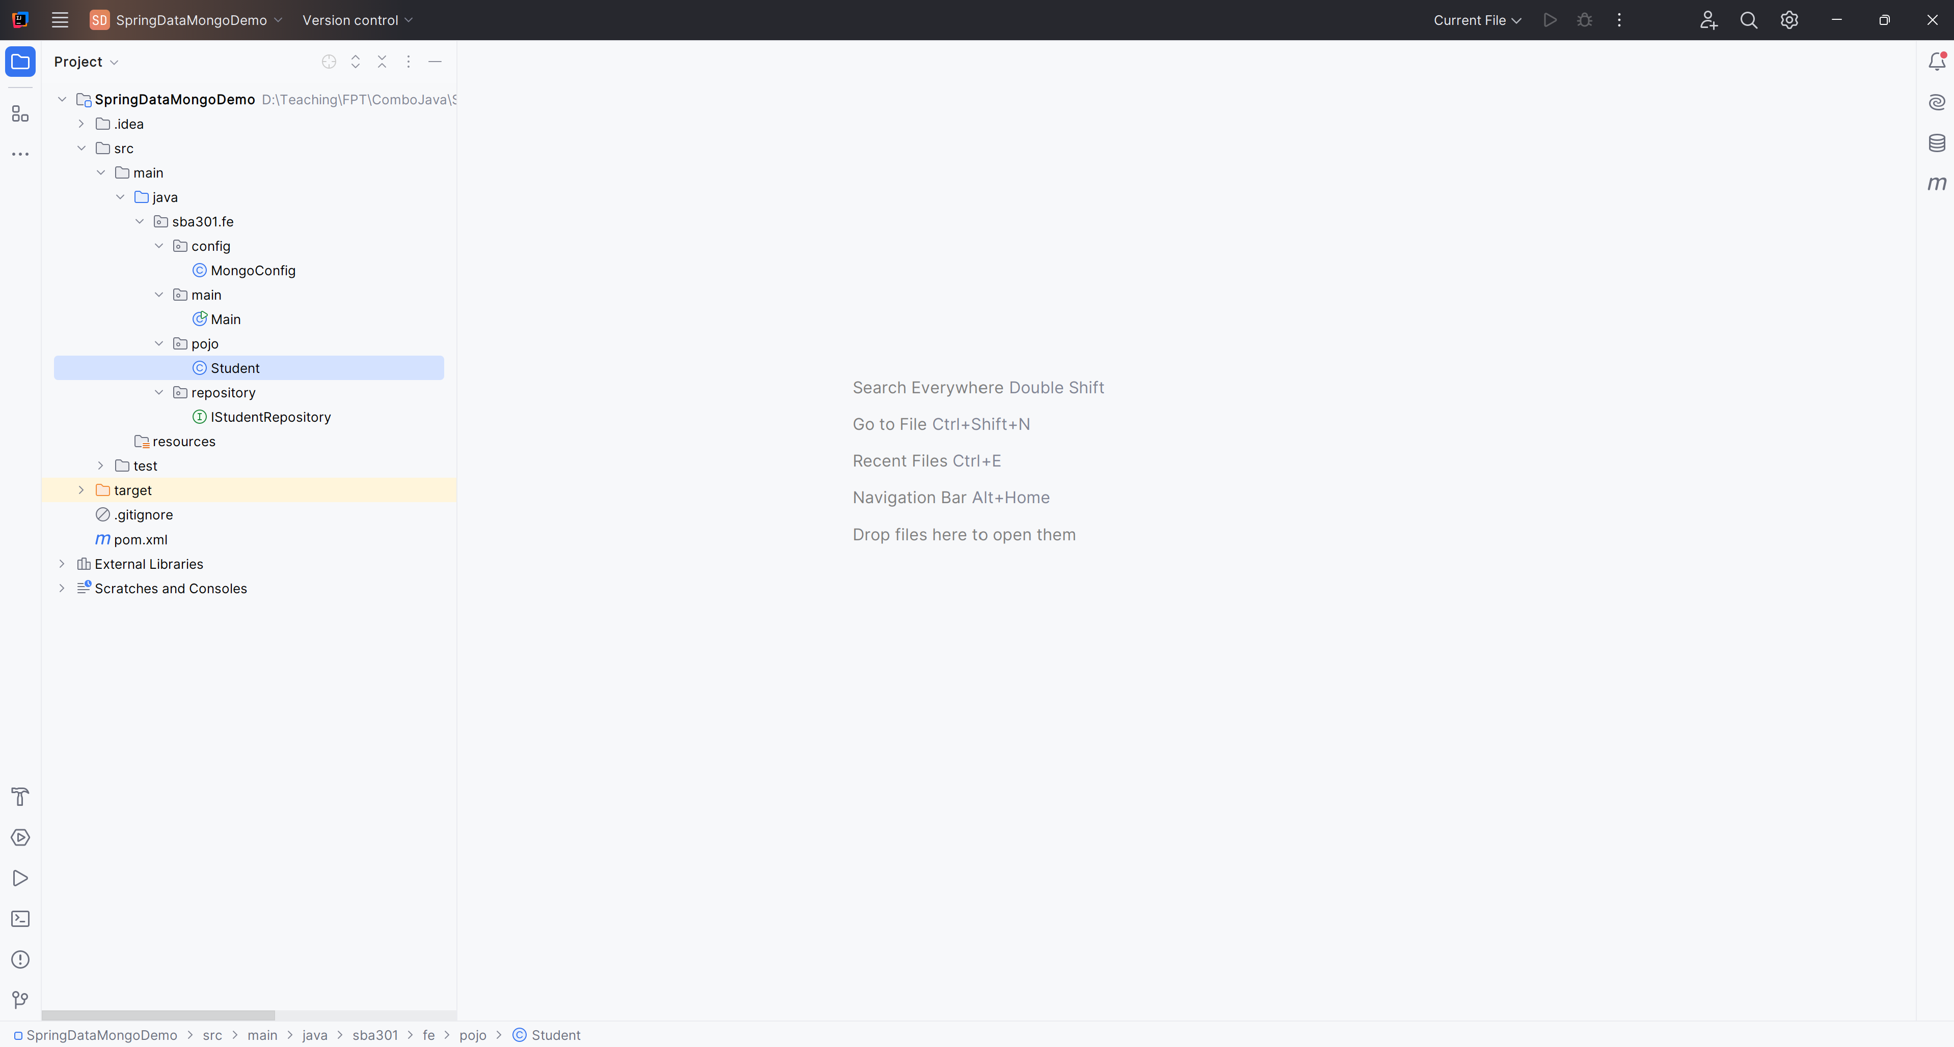
Create the Structure Project

Slide 15
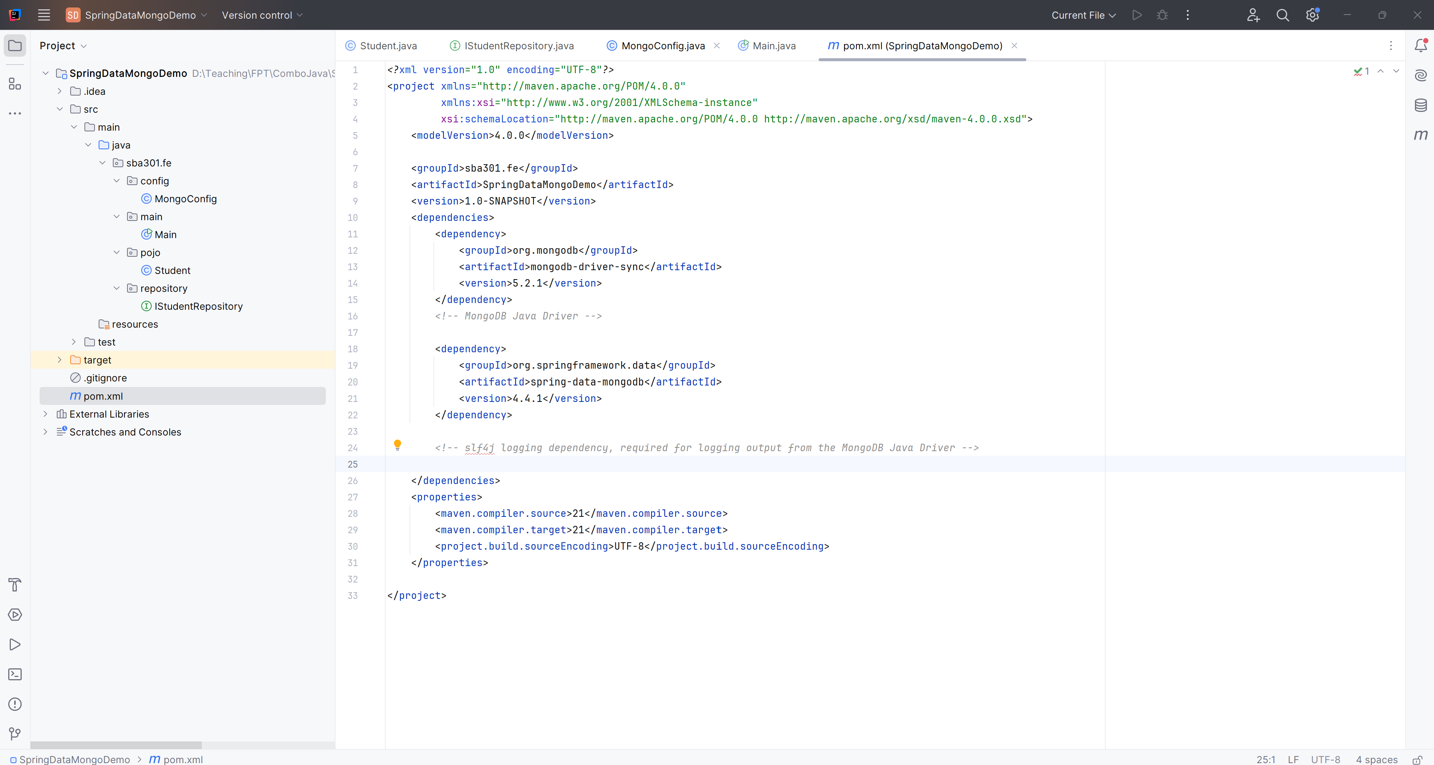
Edit pom.xml

Slide 16
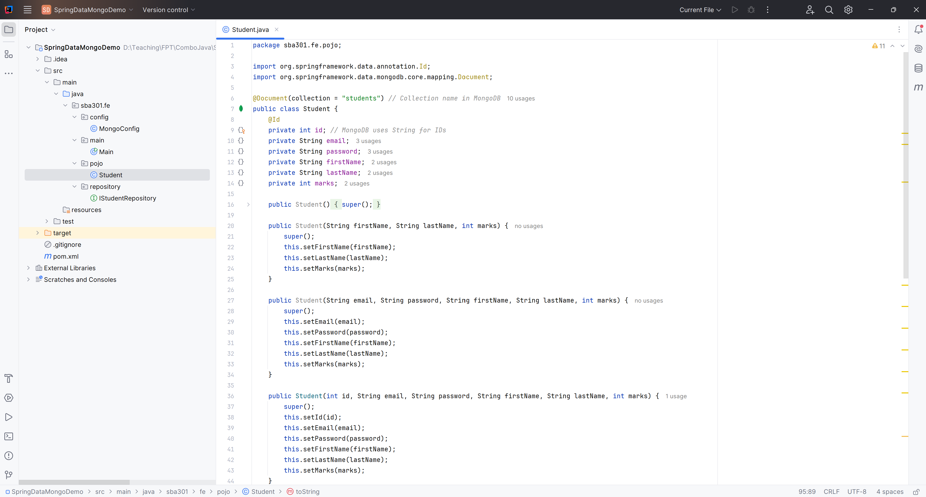
Create Student.java

Slide 17
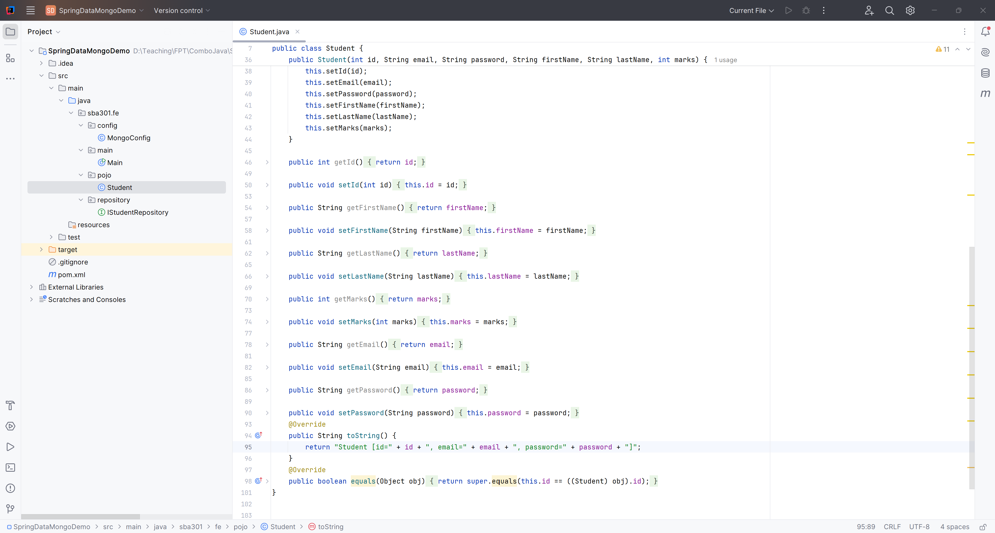
Create Student.java

Slide 18
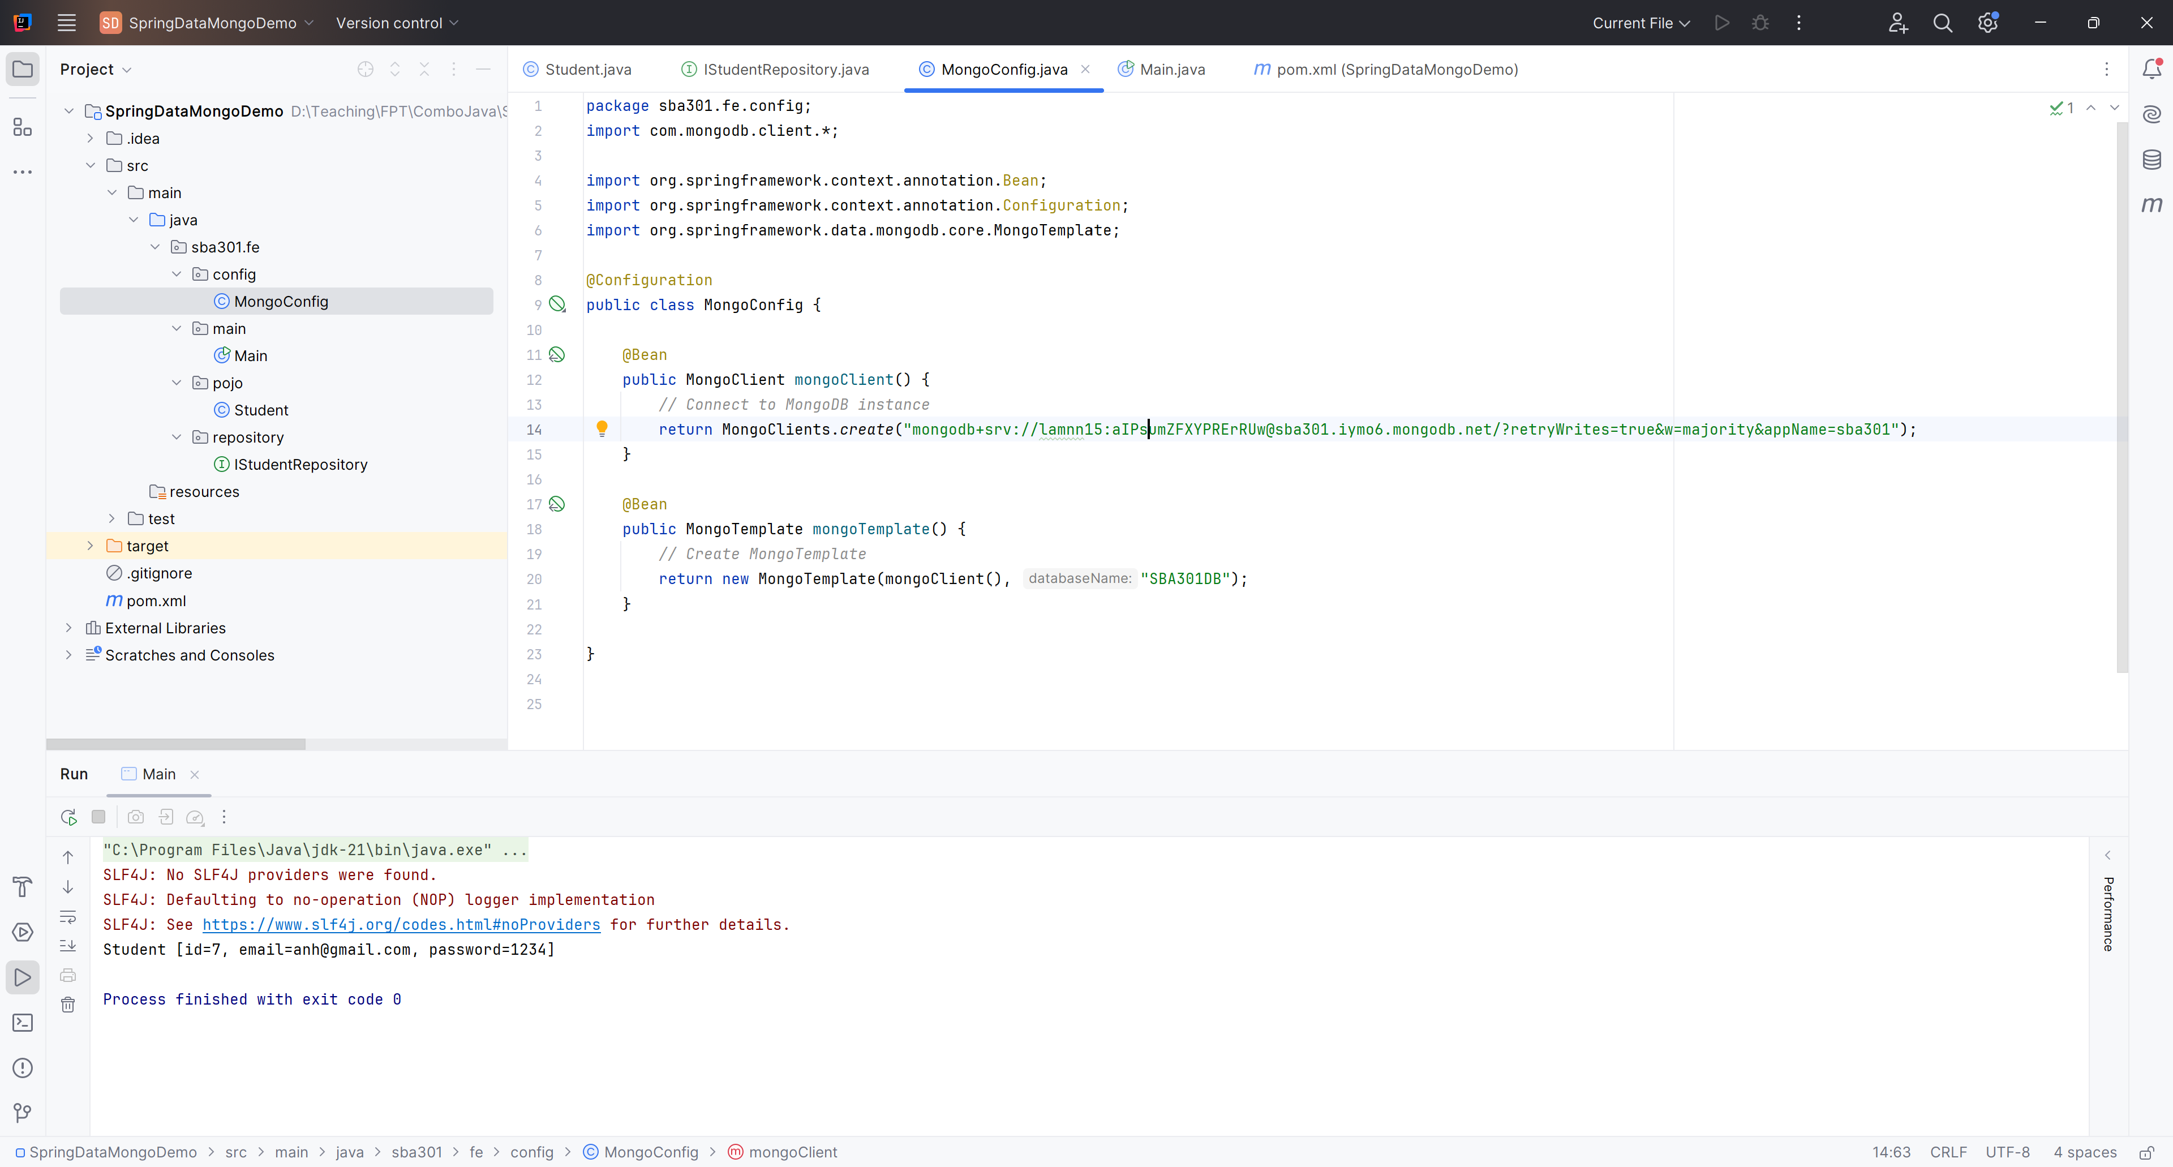
Create MongoConfig.java

Slide 19
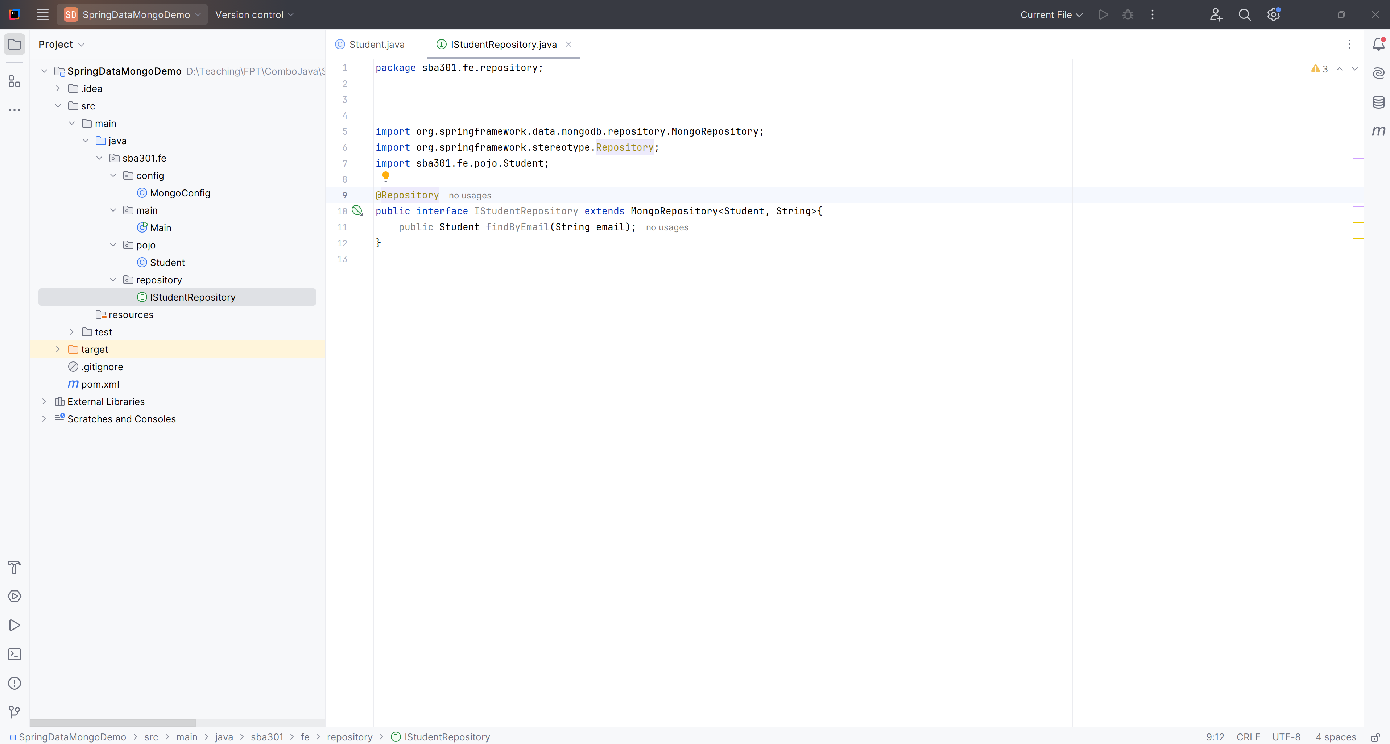
Create IStudentRepository

Slide 20
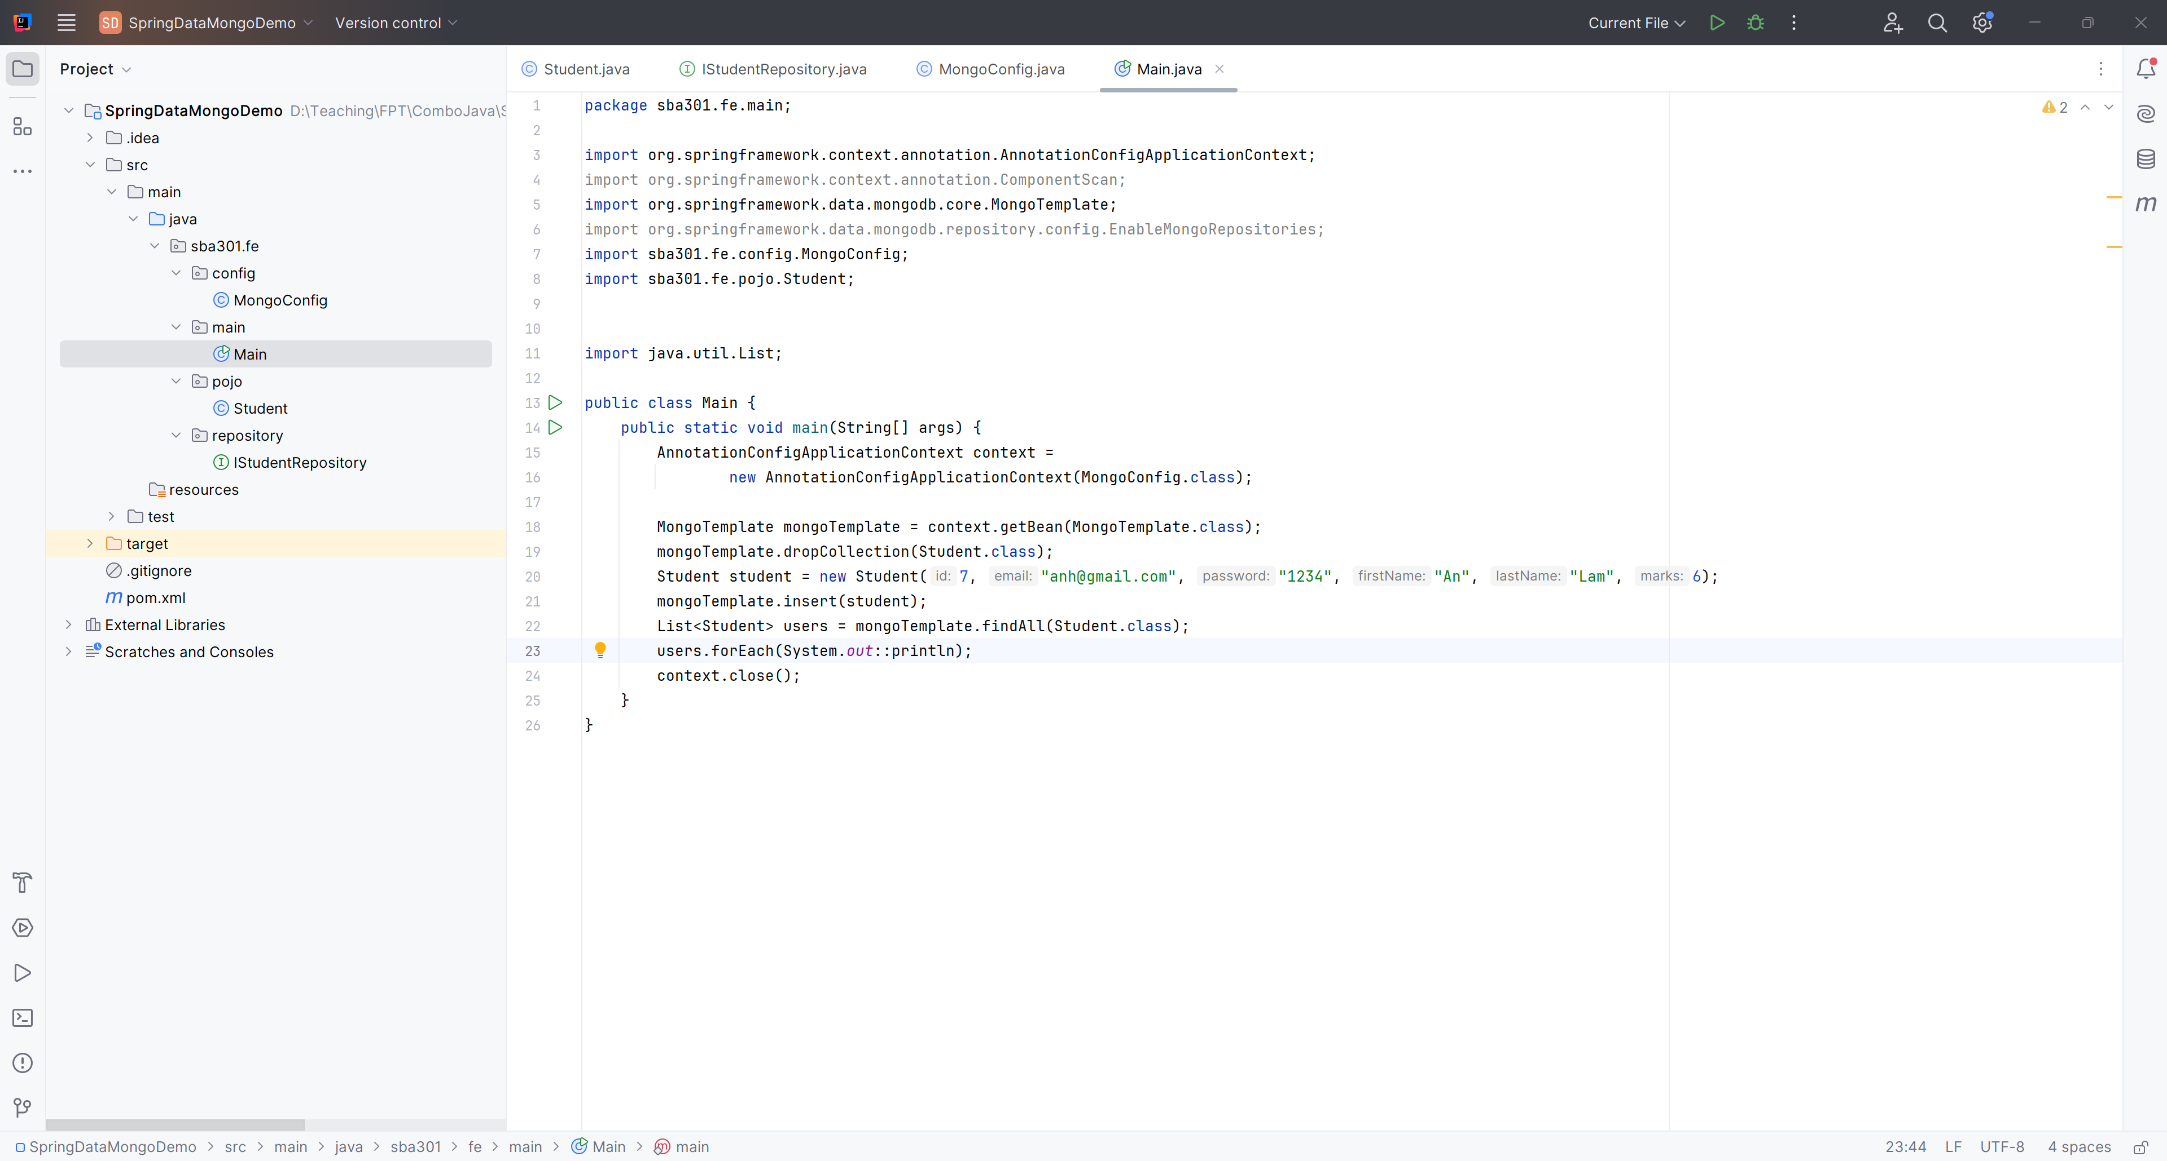
Main Function

Slide 21
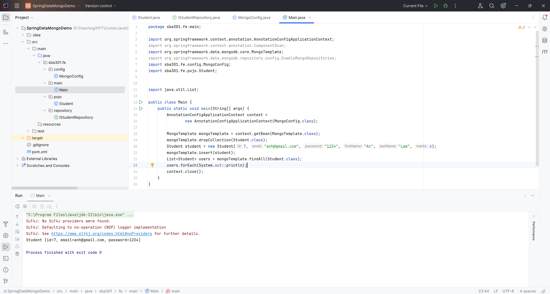
Run Project

Slide 22
Summary
Concepts were introduced:
Learn more about Spring Data MongoDB
Data Management
Implement CRUD (Create, Read, Update, Delete) operations to manage data effectively.
Utilize Spring Data Mongo, simplifying data persistence and retrieval.
CRUD Demo with Spring Data with MongoDB

